Slide 1
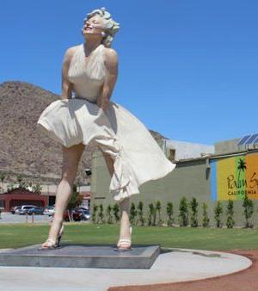
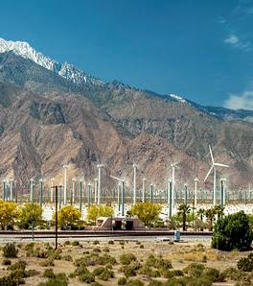
GOPA 2023 5/2/23 – 5/5/23
Palm Springs, CA

Slide 2
`

Slide 12
World Renown Air Museum

Slide 13
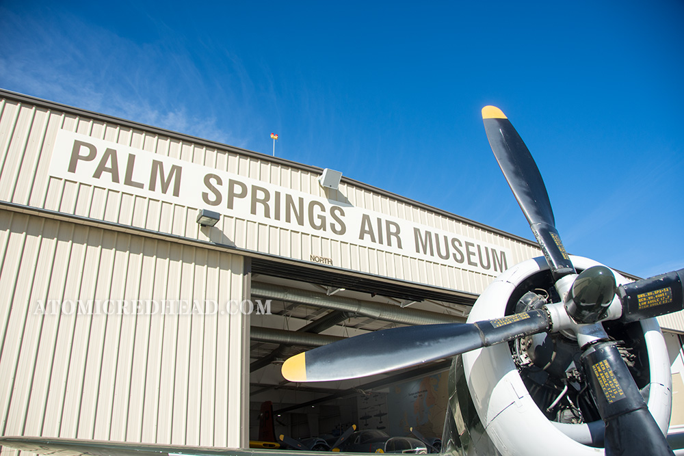

Slide 18
Palm Spring Aerial Tramway

Slide 24
Joshua Tree

Slide 29
World Famous
Cabazon Dinosaurs

Slide 30
This Photo by Unknown Author is licensed under CC BY-NC

Slide 32
This Photo by Unknown Author is licensed under CC BY-NC-ND

Slide 33
This Photo by Unknown Author is licensed under CC BY-SA

Slide 34
San Andreas Fault

Slide 36
This Photo by Unknown Author is licensed under CC BY-SA

Slide 37
This Photo by Unknown Author is licensed under CC BY

Slide 40
Living Desert Museum
and Zoo

Slide 45
This Photo by Unknown Author is licensed under CC BY

Slide 46
El Paseo Shopping

Slide 49
This Photo by Unknown Author is licensed under CC BY-SA

Slide 50
This Photo by Unknown Author is licensed under CC BY-SA

Slide 51
Convention Hotel
in Palm Desert

Slide 52
This Photo by Unknown Author is licensed under CC BY

Slide 56
This Photo by Unknown Author is licensed under CC BY

Slide 57
KUDD
Bermuda Dunes Airport
KUDD is on the Los Angeles Sectional
Non-towered
5002’ Runway
73 ft. Elevation
2 RNAV (GPS) Approaches
1 VOR-C Approach

Slide 64
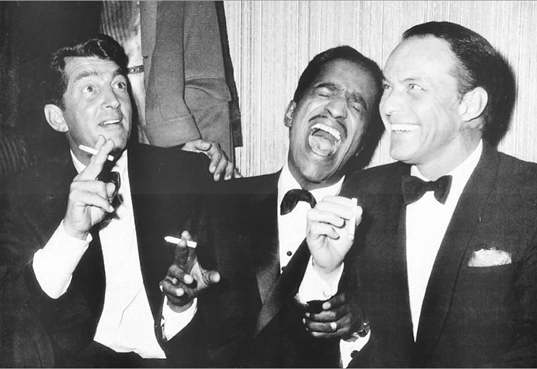
GOPA 2023
Palm Springs +
=
The Grumman Cat Pack

Slide 65
Get to GOPA 2023
In Palm Springs
For the Time of your Life!
See ya there!

